Slide 1
MVC and Design Patterns
Bill Kidwell
kidwell.bill@gmail.com

Slide 2
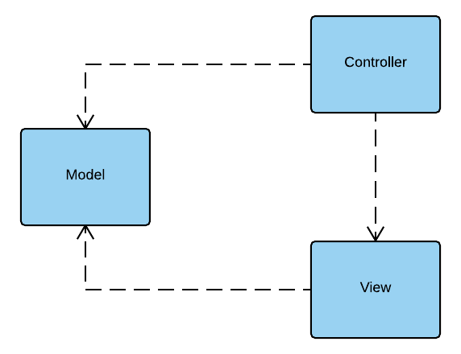
MVC
Model – application object
View – screen presentation
Controller – defines actions based on user interactions, updates model

Slide 3
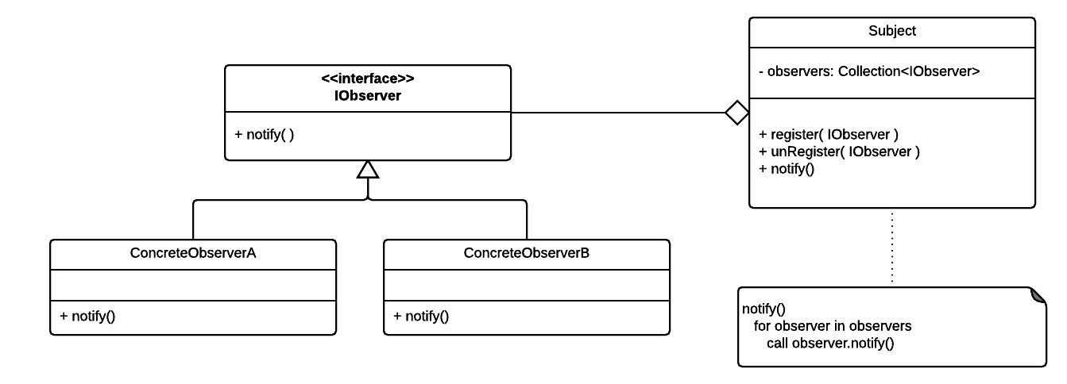
Observer Pattern
Publish-Subscribe
Listeners (e.g. event listeners)

Slide 4
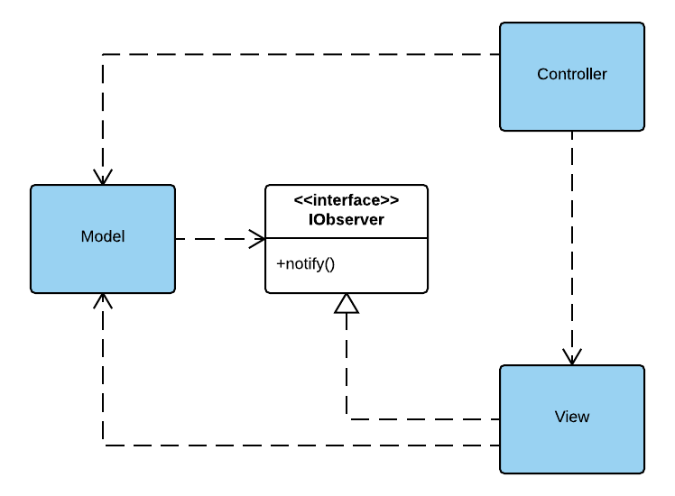
Observer in MVC
The View is notified when the state of the application changes, requiring a view to update

Slide 5
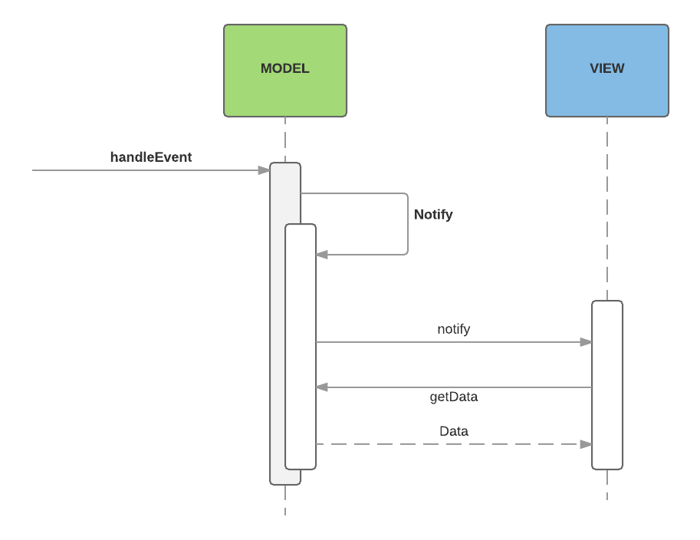
Observer in MVC

Slide 6
Composite Pattern and the View
Header
Side
Nav
Name
Address
A View is usually an example of a composite
City
State
Name
Address
City
State
Footer

Slide 7
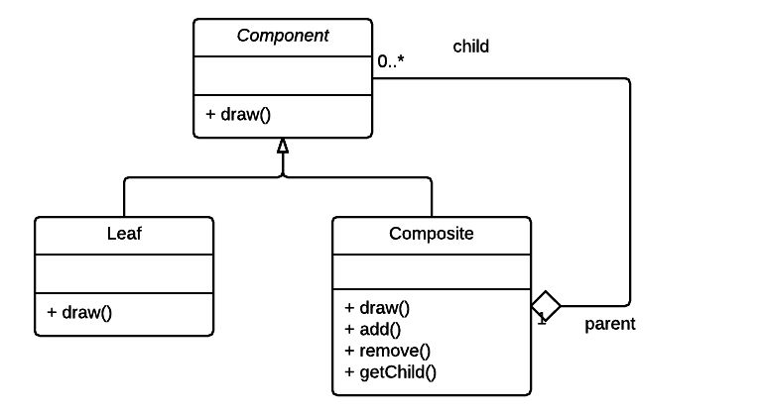
Composite
The composite pattern allows the abstraction of complexity through composition.

Slide 8
Other patterns in MVC
Strategy
Controller uses Strategy Pattern
Replace the Controller to change behavior
Command
Often, messages from View to Controller are Actions or Events

Slide 9
Conclusions
MVC organizes GUI applications
MVC is an architectural pattern
It is a good example of common Design Patterns
Architectural patterns like MVC allow you to concentrate on your domain. It separates the business logic and data from the infrastructure used to build the application.

Slide 10
Advice
Choose your application’s technology stack
Understand how your chosen framework ties things together
Spend most of your time designing your domain
Start small. Get small working. Grow in small steps.
Extra Credit
Include Unit Tests and Acceptance tests from the beginning
How did that impact the design?

